Slide 1
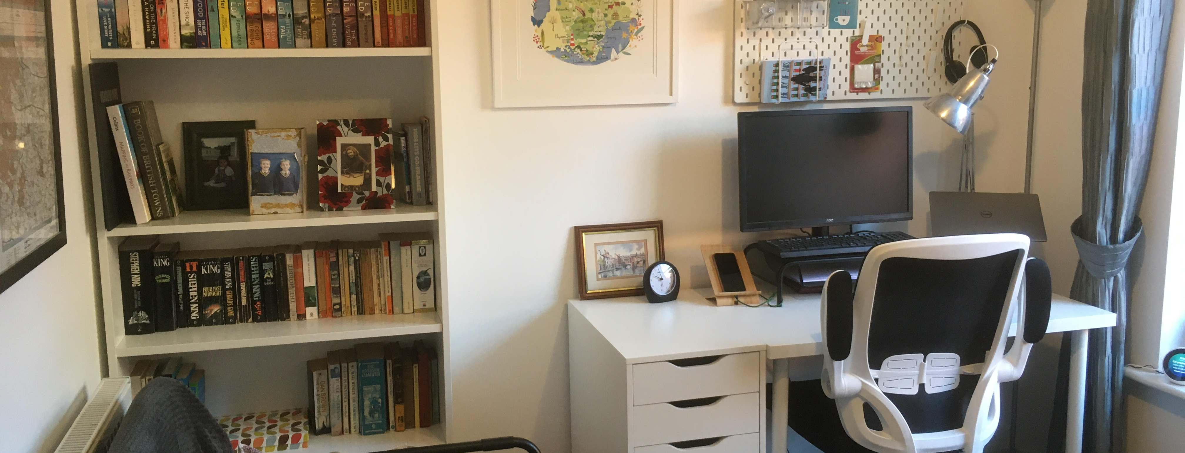
Write That Book.
From Keyboard to Kindle.
Pictures author’s own and Microsoft stock images.

Slide 2

Goals:
- Awareness
- Attitude
- Action
How ‘famous’ do you want your book to be?
What do you want people to think about your book?
What does ‘success’ look like?
Notes:
.

Slide 3

WRITING:
- What
- How
- Who
What commitment can you give to your writing?
When and where will you write?
Who will you learn from?

Slide 4

EDITING:
- Big
- Copy
- Proof
Does your writing make sense?
Is everything in order?
Is it professional?

Slide 5

MARKETING:
- Target
- Plan
- Review
Be SMART
Make it happen
Measure your results

Slide 6

PUBLISHING:
- Self
- Hybrid
- Traditional
How much control do you want?
How much risk do you want?
How much work do you want?

Slide 7

Your Writing Journey…

Slide 8

CONTACT: JOANNE BARKER AUTHOR EVENTS
Website: www.joannebarkerauthorevents.com
Email: info@joannebarkerauthorevents.com
FB: Joanne Barker Author | Facebook
Insta: Jo Barker (@jobarkerauthor) • Instagram photos and videos

